Slide 1

HS 2015
Current Trends in Distributed Systems
Midterm presentation
Group:
Patrick Zumsteg
Simon Wallny
Philipp Oldenburg

Slide 2
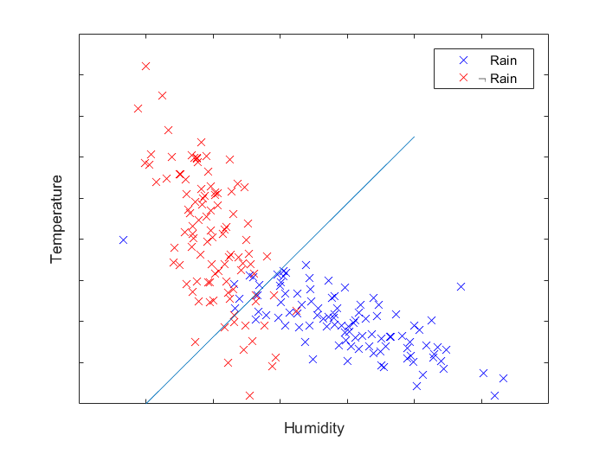
Classification
Linear Classifiers
  Naive Bayes
  SVM
4-dimensional feature space
  Temperature
  Wind speed
  Air pressure
  Humidity
HS 2015
Current Trends in Distributed Systems – Midterm presentation
<Nummer>

